Slide 1
.
Building a User-Centric Fundraising Platform: Developer Overview
Guiding developers to implement role specific features for Admins, Campaign Creators, and Contributors to ensure a seamless, engaging user experience
Ronit Raj 24SCSE1180136
Sneha Kumari 24SCSE1180010
Robin Kumar Attri 24SCSE1180682

Slide 2






Defining Key User Roles for Ploflorm Success
Distinct responsibilities of Admins, Campaign Creators, and Contributors drive efficient platform management and engagement
Admins manage platform-wide settings, oversee user accounts, and supervise all campalgne to enetse smooth operations.
Campaign Creators launch and manage fundraising campaigns, track progress, and effectively engage with contributors.
Contributors provide financial support, monitor their donations, receive updates, and maintain their personal profiles.
Clear understanding of the roles enables developers to learn features and workflows that meet user needs and improve platform interaction

Slide 3
Admin Role : Commanding Platform Management
Empowering Admins to Maintain Security, Accuracy, and Stability
Manage user accounts, including creation, modification, and deactivation
Oversee campaign activities to ensure compliance and effectiveness
Adjust site-wide settings to optimize platform performance and policies
Ensure overall platform integrity by monitoring activity and intervening as needed
Developers must implement robust access controls and intuitive interfaces for efficient admin monitoring
These functions are critical to maintaining syctem security, data accuracy, and operational stability

Slide 4
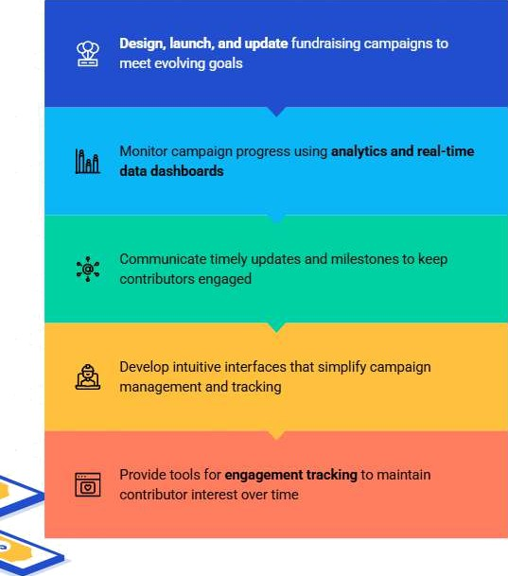

Empowering Campaign
Creators to Drive
Fund raising success
Design, manage, and optimize campaigns with real-time insights and contributor
engagement.

Slide 5

Empowering Contributors: Secure Support and
Profile Control
Ensure transparent transactions, donation tracking, and seamless profile management to build trust and encourage ongoing support.
Contributors financially support campaigns and monitor their donations overtime with clear tracking
Contributors receive regular updates
about the campaigns they support
Contributors can manage their profile information easily and securely
Developers must ensure secure transaction handling to protect contributor data and payments
Providing transparency and control fosters contributor trust and encourages continued engagement

Slide 6







Essential Dashboard Features for Campaings Creators
Empower creators with real-time insights and interactive tools to maximize campaign success
Summary views of active campaigns for quick status checks
Visual fundraising progress with progress bars and charts
Contributor engagement metrics to track supporter activity
Real-time updates to enable timely decision-making
Interactive charts and notification systems for enhanced usability
Analytics tools to help creators adjust strategies effectively

Slide 7










Empowering Contributors with lntuitive Dashboards
t
Key features enhance transparency, engagement and profile control
Clear summaries of past and current contributors to track impact
Updates and notifications from supported campaigns for timely engagement.
Visualizations like contribution history charts to enhance transparency
Profile management options for contributors to control personal information
User-friendly deaign ensuring eaey navigation and tinmly data updates
Overall, dashboards maintain contributor satisfaction and loyalty through clarity and responsiveness

Slide 8






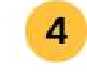
Streamlining User Actions Through Precise Inputs and Outputs
Mapping key steps ensures data integrity and immediate user feedback across platform workflows
Maintain Data Integrity
All input/autput steps ensure consistent, reliable data across the platform for
accurate tracking and reporting.
Overall, dashboards maintain contributor satisfaction and loyalty through clarity and responsiveness
Process Transactions or Updates Backend executes transactions, updates campaign or user records, and applies changes securely.
Overall, dashboards maintain contributor satisfaction and loyalty through clarity and responsiveness
Generats Outputs Platform produces confirmations, notifications, or error messages to inform users of outcomes.

Slide 9


Streamlining Contribution Confirmation
1
2
Transection Validation Securely confirm each donation to guarantee transactional integrity and prevent errors.
Update Campaign Progress Reflect the new contribution instantly on campaign dashboards to maintain accurate progress tracking.
3
.
Send Confirmation Message Notify contributors promptly with confirmation messages reinforcing trust and engagement

Slide 10

Streamlining Campaign Updates and Progress Tracking
Enable creators to edit details, track fundraising in real time, and stay informed with analytics and notifications
Submit Campaign Update Creators submit edits to campaign details through intuitive tools ensuring seamless input
Integrate Analytics and Notifications Analytic provide insights while notifications keep creators informed of key changes and contributions.
Process and Validate Data System validates updates and integrate changes into the database with real-time synchronization.
Refresh the dashboard, and it updates instantly to reflect the current fundraising progress and campaign metrics.

Slide 11
O Enable contributors and users to manage profile information easily and securely
O
O
Enable contributors and users to manage profile information easily and securely
Implement input validation on
forms to ensure data accuracy and completeness
O
O
Maintain accurate profiles to support personalized communication and platform reliability
Provide clear update confirmation to assure users their changes are saved

Slide 12

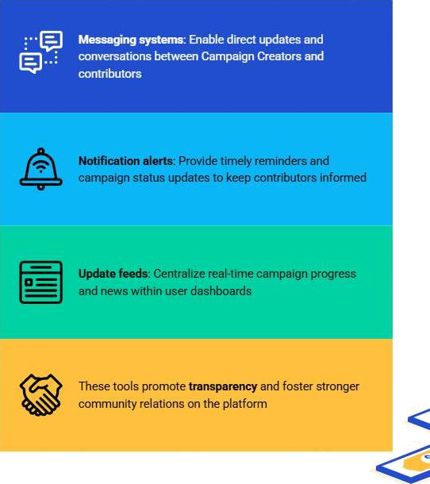
Communication Features:
Connecting Creators and Contributors
Implement messaging, notifications, and update feels to enhance engagement

Slide 13



Ensuring Data Integrity and System Reliability
Key practices to protect user data and maintain continuous platform trust

Slide 14













Overcoming Key Development Challenges
Strategies to Build Resilient, Scalable Solutions
Leverage APIs for data exchange to enable seamless integration between user dashboards and
backend services.
Ensure real-time data synchronization for accurate campaign updates and contributor communications
Manage secure financial amsamions to protem contributor payrnems and platform integrity
Handle OOMJ:DEV
user permissions to
ensure proper access control for admins, campaign creators, and contributors
lmplements thorough tech bug to identify and resolve issues early, ensuring platform
reliability
Maintains an awareness of challenges to proactively deliver resilient and scalable solutions.
Adopt architectural patterns to enhance maintainability and scalability across platform features.

Slide 15












Key Developer Priorities to Drive Platform Success
User roles demand distinct access roles:- Admin, Campaign Creator, Contributor.
Design tailored dashboards that meet each role's specific needs.
Implement robust input/output workflows to ensure smooth user imeractton8
Maintain strict data integrity and security to protect user information.
Prioritize usability and real- time feedback to enhance user satisfamion
Proactively address common challenges for scalable, reliable platform delivery
Deliver solutions that empower campaign success and foster community engagement

